Slide 1
UNIT V
18CSC304J– COMPILER DESIGN

Slide 2
UNIT 5
BASIC BLOCKS,FLOW GRAPHS
NEXT-USE INFORMATION
PRINCIPAL SOURCES OF OPTIMIZATION
FUNCTION PRESERVING TRANSFORMATION
LOOP OPTIMIZATION
PEEPHOLE OPTIMIZATION
INTRODUCTION TO GLOBAL DATA FLOW ANALYSIS
COMPUTATION OF GEN AND KILL
COMPUTATION OF IN AND OUT
OPTIMIZTION OF BASIC BLOCKS
BUILDING EXPRESSION OF DAG
RUNTIME ENVIRONMENTS
SOURCE LANGUAGE ISSUES
STORAGE ORGANIZATION
ACTIVATION RECORDS
STORAGE ALLOCATION STRATEGIES
PARAMETER PASSING

Slide 3
Basic Blocks and Flow Graphs

Slide 4
Basic Blocks and Flow Graphs
Graph representation of intermediate code is helpful for discussing code generation even if the graph is not constructed explicitly by a code-generation algorithm.
We can do a better job of register allocation if we know how values are defined and used
We can do a better job of instruction selection by looking at sequences of three-address statements
The representation is constructed as follows:
Partition the intermediate code into basic blocks, which are maximal sequences of consecutive three-address instructions with the properties that
The flow of control can only enter the basic block through the first instruction in the block. That is, there are no jumps into the middle of the block.
Control will leave the block without halting or branching, except possibly at the last instruction in the block.
The basic blocks become the nodes of a flow graph, whose edges indicate which blocks can follow which other blocks.

Slide 5
Basic Block
Our first job is to partition a sequence of three-address instructions into basic blocks.
We begin a new basic block with the first instruction and keep adding instructions until we meet either a jump, a conditional jump, or a label on the following instruction.
In the absence of jumps and labels, control proceeds sequentially from one instruction to the next.
This idea is formalized in the following algorithm.

Slide 6
Partitioning three-address instructions into basic blocks
INPUT: A sequence of three-address instructions.
OUTPUT: A list of the basic blocks for that sequence in which each instruction is assigned to exactly one basic block.
METHOD: First, we determine those instructions in the intermediate code that are leaders, that is, the first instructions in some basic block. The instruction just past the end of the intermediate program is not included as a leader. The rules for finding leaders are:
1. The first three-address instruction in the intermediate code is a leader.
2. Any instruction that is the target of a conditional or unconditional jump is a leader.
3. Any instruction that immediately follows a conditional or unconditional jump is a leader

Slide 7
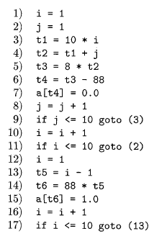
Example
Rule 1. The first three-address instruction in the intermediate code is a leader.
Rule 2. Any instruction that is the target of a conditional or unconditional jump is a leader.
Rule 3. Any instruction that immediately follows a conditional or unconditional jump is a leader
Leader
First, instruction 1 is a leader by rule (I) of Algorithm 8.5.
To find the other leaders, we first need to find the jumps.
In this example, there are three jumps, all conditional, at instructions 9, 11, and 17.
By rule (2), the targets of these jumps are leaders; they are instructions 3, 2, and 13, respectively.
Then, by rule (3), each instruction following a jump is a leader; those are instructions 10 and 12.
We conclude that the leaders are instructions 1, 2, 3, 10, 12, and 13.
The basic block of each leader contains all the instructions from itself until just before the next leader.
Thus, the basic block of 1 is just 1, for leader 2 the block is just 2.
Leader 3, however, has a basic block consisting of instructions 3 through 9, inclusive.
Instruction 10's block is 10 and 11; instruction 12's block
is just 12, and instruction 13's block is 13 through 17

Slide 8
Next-Use Information
Knowing when the value of a variable will be used next is essential for generating good code
The use of a name in a three-address statement is defined as follows.
Suppose three-address statement i assigns a value to x.
If statement j has x as an operand, and control can flow from statement i to j along a path that has no intervening assignments to x, then we say statement j uses the value of x computed at statement i.
We further say that x is live at statement i.

Slide 9
Next-Use Information
Algorithm: Determining the liveness and next-use information for each statement in a basic block.
INPUT: A basic block B of three-address statements. We assume that the symbol table initially shows all nontemporary variables in B as being live on exit.
OUTPUT: At each statement i: x = y + z in B, we attach to i the liveness and next-use information of x, y, and z.
METHOD: We start at the last statement in B and scan backwards to the beginning of B. At each statement i: x = y + z in B, we do the following:
Attach to statement i the information currently found in the symbol table regarding the next use and liveness of x, y, and z.
In the symbol table, set x to "not live" and "no next use."
In the symbol table, set y and z to "live" and the next uses of y and z to i

Slide 10
Flow Graphs
If we have two block B and C
There is an edge from block B to block C if and only if it is possible for the first instruction in block C to immediately follow the last instruction in block B.
There are two ways that such an edge could be justified:
There is a conditional or unconditional jump from the end of B to the beginning of C.
C immediately follows B in the original order of the three-address instructions, and B does not end in an unconditional jump.

Slide 11
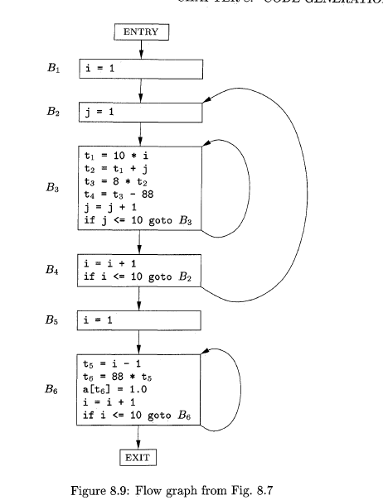
The leaders are instructions 1, 2, 3, 10, 12, and 13

Slide 12
The Principal Sources of Optimization

Slide 13
The Principal Sources of Optimization
A compiler optimization must preserve the semantics of the original program.
Except in very special circumstances, once a programmer chooses and implements a particular algorithm, the compiler cannot understand enough about the program to replace it with a substantially different and more efficient algorithm.
A compiler knows only how to apply relatively low-level semantic transformations, using general facts

Slide 14
Causes of Redundancy
There are many redundant operations in a typical program.
Sometimes the redundancy is available at the source level. For instance, a programmer may find it more direct and convenient to recalculate some result, leaving it to the compiler to recognize that only one such calculation is necessary.
But more often, the redundancy is a side effect of having written the program in a high-level language

Slide 15
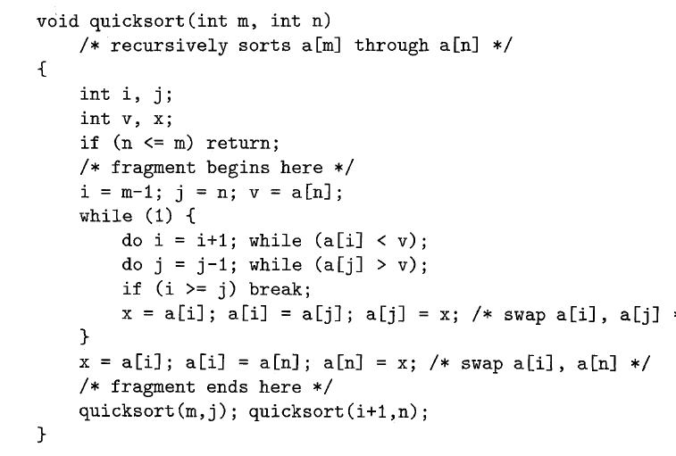
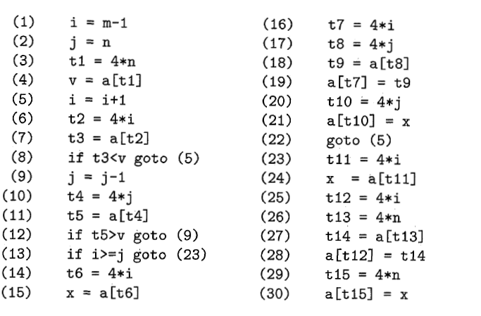

Slide 16
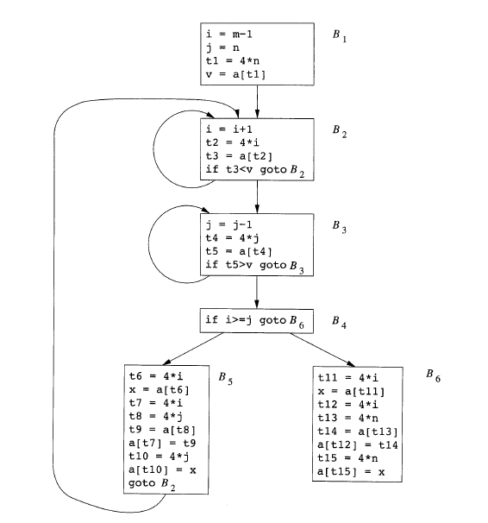

Slide 17
Semantics-Preserving Transformations
There are a number of ways in which a compiler can improve a program without changing the function it computes.
Common-subexpression elimination,
copy propagation,
dead-code elimination, and constant folding
are common examples of such function-preserving (or semantics-preserving) transformations

Slide 18
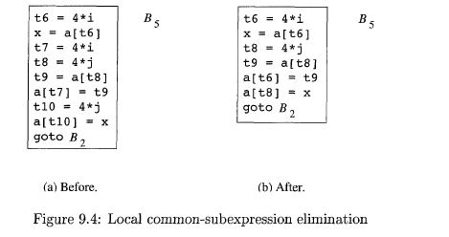
Common-sub expression elimination
Local common sub expression elimination

Slide 19
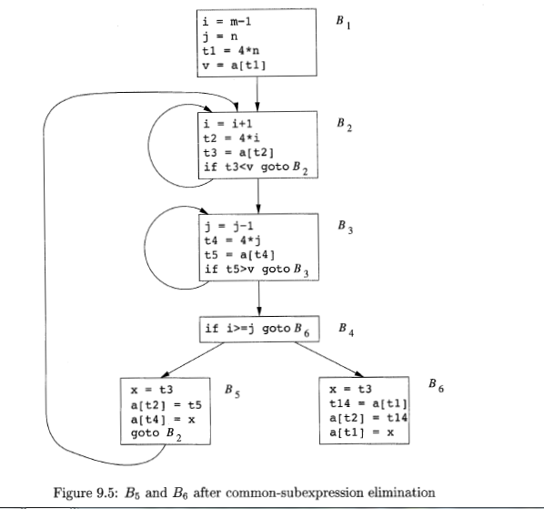

Slide 20
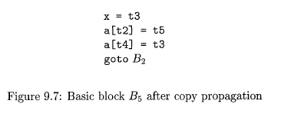

Copy Propagation
Block B5 can be further improved by eliminating x, using two new transformations.
One concerns assignments of the form u = v called copy statements, or copies for short
The idea behind the copy-propagation transformation is to use v for u, wherever possible after the copy statement u = v.

Slide 21

Dead-Code Elimination
A variable is live at a point in a program if its value can be used subsequently
otherwise, it is dead at that point.
A related idea is dead (or useless) code - statements that compute values that never get used.
One advantage of copy propagation is that it often turns the copy statement into dead code

Slide 22
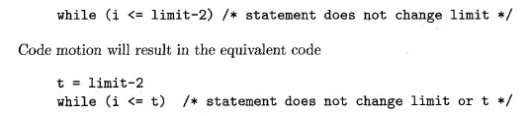
CodeMotion
Loops are a very important place for optimizations, especially the inner loops where programs tend to spend the bulk of their time.
The running time of a program may be improved if we decrease the number of instructions in an inner loop, even if we increase the amount of code outside that loop.
An important modification that decreases the amount of code in a loop is code motion

Slide 23
Induction Variables and Reduction in Strength
Another important optimization is to find induction variables in loops and optimize their computation.
A variable x is said to be an "induction variable“ if there is a positive or negative constant c such that each time x is assigned, its value increases by c.
The transformation of replacing an expensive operation, such as multiplication, by a cheaper one, such as addition, is known as strength reduction.

Slide 24
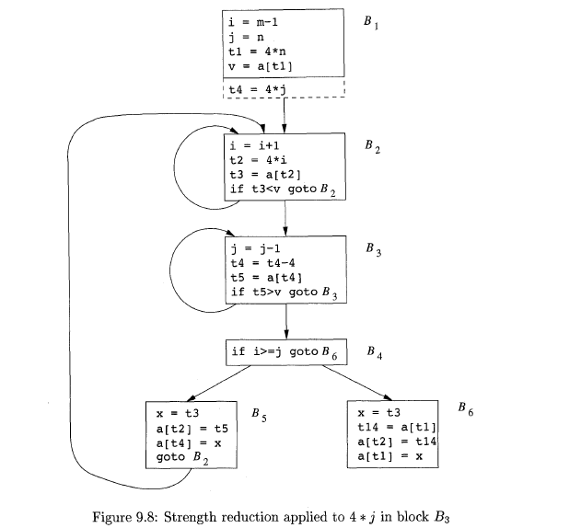

Slide 25
Loop Optimization

Slide 26

Loop Optimization
Loop optimization is the process of increasing execution speed and reducing the overheads associated with Loops
In loops, especially in the inner loops, programs tend to spend the bulk of their time.
The running time of a program may be improved if the number of instructions in an inner loop is decreased, even if we increase the amount of code outside that loop.
Three techniques are important for loop optimization:
Code motion, which moves code outside a loop
Induction-variable elimination, which we apply to replace variables from inner loop.
Reduction in strength, which replaces and expensive operation by a cheaper one, such as a multiplication by an addition.

Slide 27
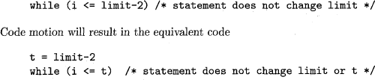
Code Motion
Loops are a very important place for optimizations, especially the inner loops where programs tend to spend the bulk of their time.
The running time of a program may be improved if we decrease the number of instructions in an inner loop, even if we increase the amount of code outside that loop.
An important modification that decreases the amount of code in a loop is code motion

Slide 28
Induction Variables and Reduction in Strength
Another important optimization is to find induction variables in loops and optimize their computation.
A variable x is said to be an "induction variable“ if there is a positive or negative constant c such that each time x is assigned, its value increases by c.
The transformation of replacing an expensive operation, such as multiplication, by a cheaper one, such as addition, is known as strength reduction.

Slide 29

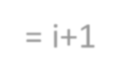

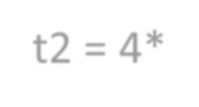
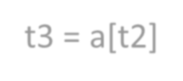




Induction Variables and Reduction in Strength
For instance, i and t2 are induction variables in the loop containing B2 (shown below).
i= i+1 t2 = 4*i
t3 = a[t2]
If t3 < v goto B2
(Block 2)
induction variables not only allow us sometimes to perform a strength reduction;
often it is possible to eliminate all but one of a group of induction variables whose values remain in lock step as we go around the loop.

Slide 30
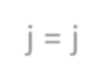



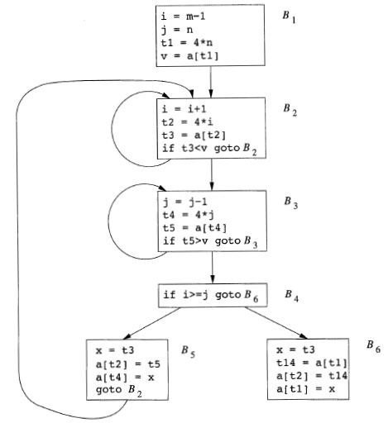
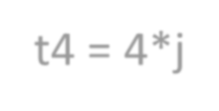








Induction Variables and Reduction in Strength
j = j-1 t4 = 4*j
t5 = a[t4]
if t5>v goto B3
(Block 3)
Note that the values of j and t4 remain in lock step;
every time the value of j decreases by 1, the value of t4 decreases by 4, because 4 * j is assigned to t4.
These variables, j and t4, thus form a good example of a pair of induction variables.
When there are two or more induction variables in a loop, it
may be possible to get rid of all but one.
Here in B3 , we cannot get rid of either j or t4 completely; t4 is used in B3 and j is used in B4.
However, we can illustrate reduction in strength and a part of
the process of induction-variable elimination.

Slide 31

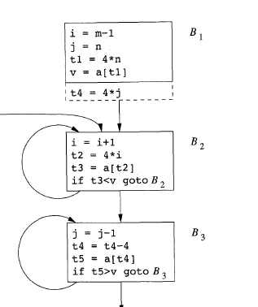




Induction Variables and Reduction in Strength
As the relationship t4 = 4 * j surely holds after assignment to t4 in and t4 is not
changed elsewhere in the inner loop around B3
it follows that just after the statement j = j -1 the relationship t4 = 4 * j – 4
must hold.
We may therefore replace the assignment t4 = 4* j by t4 = t4-4.
The only problem is that t4 does not have a value when we enter block B3 for
the first time.
Since we must maintain the relationship t4 = 4 * j on entry to the block B3, we place an initialization of t4 at the end of the block where j itself is initialized
So in block B1 we can added one more instruction, which is executed once in
block B1,
The replacement of a multiplication by a subtraction will speed up the object code if multiplication takes more time than addition or subtraction, as is the case on many machines

Slide 32

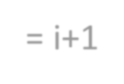

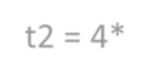
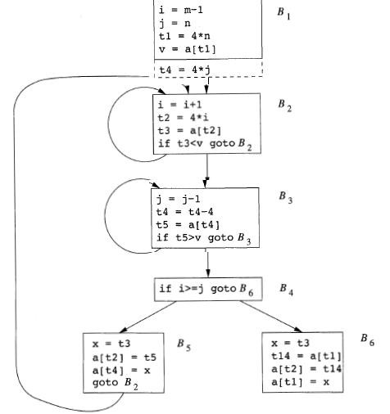





Induction Variables and Reduction in Strength
i= i+1 t2 = 4*i
t3 = a[t2]
If t3 < v goto B2
(Block 2)
After reduction in strength is applied to the inner loops
around B2 and B3
The only use of i and j is to determine the outcome of the test in block B4.
We know that the values of i and t2 satisfy the relationship
t2 = 4 * i,
while those of j and t4 satisfy the relationship t4 = 4* j.
Thus, the test t2 ≥ t4 can substitute for i ≥ j.
Once this replacement is made, i in block B2 and j in block B3 become dead variables,
Then the assignments to them in these blocks become dead
code that can be eliminated.
Prepared by R I Minu
29

Slide 33
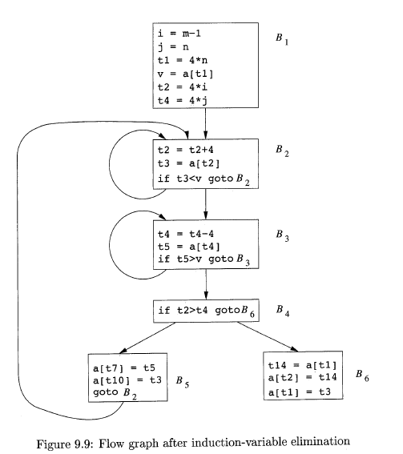

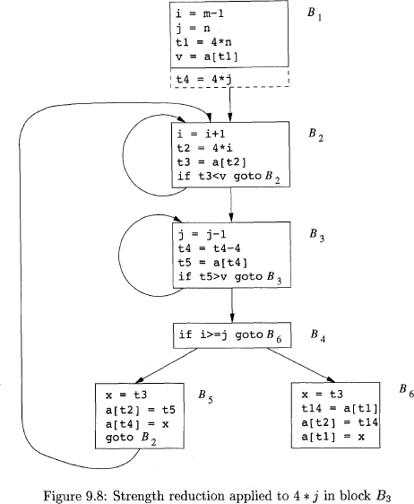

Slide 34
Peephole Optimization

Slide 35
Peephole Optimization
A simple but effective technique for locally improving the target code is peephole optimization
This is done by examining a sliding window of target instructions (called the peephole) and replacing instruction sequences within the peephole by a shorter or faster sequence, whenever possible.
Peephole optimization can also be applied directly after intermediate code generation to improve the intermediate representation.

Slide 36
Peephole Optimization
we shall see the following examples of program transformations that are characteristic of peephole optimizations:
Redundant-instruction elimination
Flow-of-control optimizations
Algebraic simplifications
Use of machine idioms

Slide 37
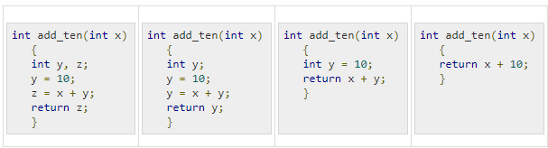

Redundant instruction elimination
At compilation level, the compiler searches for instructions redundant in nature. Multiple loading and storing of instructions may carry the same meaning even if some of them are removed.
Eliminating Redundant Loads and Stores

Slide 38

Unreachable code
Unreachable code is a part of the program code that is never accessed because of programming constructs. Programmers may have accidently written a piece of code that can never be reached.
In this code segment, the printf statement will never be executed as the program control returns back before it can execute, hence printf can be removed.

Slide 39
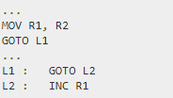

Flow of control optimization
There are instances in a code where the program control jumps back and forth without performing any significant task. These jumps can be removed. Consider the following chunk of code:
In this code,label L1 can be removed as it passes the control to L2. So instead of jumping to L1 and then to L2, the control can directly reach L2, as shown below:

Slide 40
Algebraic expression simplification
There are occasions where algebraic expressions can be made simple.
For example, the expression a = a + 0 can be replaced by a itself
The expression a = a + 1 can simply be replaced by INC a.

Slide 41
Strength reduction
There are operations that consume more time and space.
Their ‘strength’ can be reduced by replacing them with other operations that consume less time and space, but produce the same result.
For example,
x * 2 can be replaced by x << 1, which involves only one left shift.
Though the output of a * a and a² is same, a² is much more efficient to implement.

Slide 42
Use of Machine Idioms
The target machine may have hardware instructions to implement certain specific operations efficiently.
Detecting situations that permit the use of these instructions can reduce execution time significantly.
For example,
some machines have auto-increment and auto-decrement addressing modes.
These add or subtract one from an operand before or after using its value.
The use of the modes greatly improves the quality of code when pushing or popping a stack, as in parameter passing.

Slide 43
Introduction to Data-Flow Analysis

Slide 44
Introduction to Data-Flow Analysis
All the optimizations depend on data-flow analysis.
"Data-flow analysis" refers to a body of techniques that derive information about the flow of data along program execution paths.
For example, one way to implement global common sub-expression elimination requires us to determine whether two textually identical expressions evaluate to the same value along any possible execution path of the program.
As another example, if the result of an assignment is not used along any subsequent execution path, then we can eliminate the assignment as dead code.

Slide 45
The Data-Flow Abstraction - path
The execution of an intermediate-code statement transforms an input state to a new output state.
The input state = the program point before the statement
The output state = the program point after the statement
For analysing the behaviour of a program, we should consider all the possible sequences of program points -Paths
This can be done through flow graph

Slide 46
Possible execution paths
The flow graph tells us about the possible execution paths
Within one basic block, the program point after a statement is the same as the program point before the next statement.
If there is an edge from block B1 to block B2, then the program point after the last statement of B1 may be followed immediately by the program point before the first statement of B2.

Slide 47
Possible execution paths
We may define an execution path (or just path) from point p₁ to point p_{n}, to be a sequence of points p₁ ,p₂, . . . , P_{n} such that for each i = 1,2, . . . , n - 1, either
p_{i} is the point immediately preceding a statement and p_{i+1} is the point immediately following that same statement, or
p_{i} is the end of some block and p_{i+1} is the beginning of a successor block.
“In general, there is an infinite number of possible execution paths through a program, and there is no finite upper bound on the length of an execution path”

Slide 48

The Data-Flow Analysis Schema
In each application of data-flow analysis, we associate with every program point a data-flow value that represents an abstraction of the set of all possible program states that can be observed for that point.
We denote the data-flow values before and after each statements by IN[S] and OUT[S], respectively.
The data-flow problem is to find a solution to a set of constraints on the IN[s]'s and OUT[S]'s, for all statements.
There are two sets of constraints:
Those based on the semantics of the statements ( "transfer functions")
Those based on the flow of control.

Slide 49

Transfer Functions (semantics of the statements )
The data-flow values before and after a statement are constrained by the semantics of the statement.
For example,
If variable a has value v before executing statement b = a, then both a and b will have the value v after the statement.
This relationship between the data-flow values before and after the assignment statement is known as a transfer function.

Slide 50
Transfer Functions
Transfer functions come in two flavors: information may propagate forward along execution paths, or it may flow backwards up the execution paths
In a forward-flow problem, the transfer function of a statement s, which we shall usually denote f_{S} takes the data-flow value before the statement and produces a new data-flow value after the statement. That is,
OUT[S] = F_{S}(IN[S])
Conversely, in a backward-flow problem, the transfer function f, for statement s converts a data-flow value
IN[S] = F_{S}(OUT[S])

Slide 51
Control-Flow Constraints
Within a basic block, control flow is simple.
If a block B consists of statements s₁ , s₂, . . . , S_{n} in that order, then the control-flow value out of s_{i} is the same as the control-flow value into s_{i+1}. That is,
IN[S_{i+1}] = OUT[S_{i}], for all i = 1,2,3...n-1
Control-flow edges between basic blocks create more complex constraints between the last statement of one basic block and the first statement of the following block.

Slide 52
Data-Flow Schemas on Basic Blocks
We denote the data-flow values immediately before and immediately after each basic block B by IN[B] and OUT[B],respectively.
The constraints involving IN[B]and OUT[B] can be derived from those involving IN[S] and OUT[S] for the various statements s in B as follows.
Suppose block B consists of statements s₁, . . . , s_{n} in that order.
If s₁ is the first statement of basic block B, then
IN[B] = lN[s₁],

Slide 53
Data-Flow Schemas on Basic Blocks
Similarly, if s_{n} is the last statement of basic block B, then
OUT[B] = OUT[S_{n}].
The transfer function of a basic block B, which we denote f_{B}, can be derived by composing the transfer functions of the statements in the block.
That is, let f_{Si} be the transfer function of statement s_{i}.
Then f_{B} = f_{sn} o f_{s(n-1)}. . . o f_{s2} o f_{s1}.
The relationship between the beginning and end of the block is
OUT[B] = f_{B}(IN[B])

Slide 54

Data-Flow Schemas on Basic Blocks
The constraints due to control flow between basic blocks can easily be rewritten by substituting IN[B] and OUT[B] for lN[s₁] and OUT[S_{n}], respectively.
For instance, if data-flow values are information about the sets of constants that may be assigned to a variable, then we have a forward- flow problem in which

Slide 55

Data-Flow Schemas on Basic Blocks
The data-flow is backwards as we shall soon see in live-variable analysis, the equations are similar, but with the roles of the IN'S and OUT'S reversed.

Slide 56

Reaching Definitions
"Reaching definitions" is one of the most common, and useful data- flow schemas.
For Example:
By knowing where in a program each variable x may have been defined when control reaches each point pi we can determine many things about x.
For just two examples, a compiler then knows whether x is a constant at
point p, and
a debugger can tell whether it is possible for x to be an undefined variable, should x be used at p.

Slide 57
Reaching Definitions
Let in a block definition d reaches a point p if there is a path from the point immediately following d to p_{i} such that d is not “killed“ along that path.
We kill a definition of a variable x if there is any other definition of x anywhere along the path.
A definition of a variable x is a statement that assigns, or may assign, a value to x .
Procedure parameters, array accesses, and indirect references all may have aliases, and it is not easy to tell if a statement is referring to a particular variable x

Slide 58
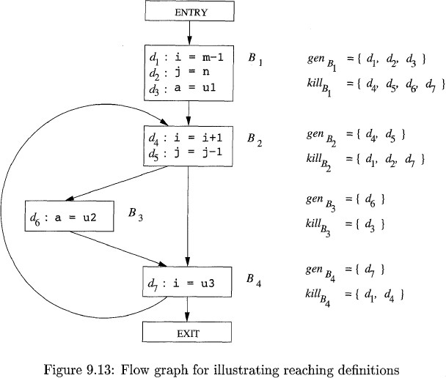

Reaching Definitions : Example
The figure is a flow graph with seven definitions.
Let us focus on the definitions reaching block B2.
All the definitions in block B1 reach the beginning of block B2.
The definition d5: j = j-1 in block B2 also reaches the beginning of block B2, because no other definitions of j can be found in the loop leading back to B2.
This definition, however, kills the definition d2: j = n, preventing it from reaching B3 or B4.
The statement d4: i = i+l in B2 does not reach the beginning of B2 though, because the variable i is always redefined by d7: i = u3.
Finally, the definition d6 : a = u2 also reaches the
beginning of block B2

Slide 59
Transfer Equations for Reaching Definitions
Consider a statement
d: u=v+w
This statement "generates" a definition d of variable u and "kills" all the other definitions in the program that define variable u, while leaving the remaining incoming definitions unaffected.

Slide 60


Transfer Equations for Reaching Definitions
The transfer function of definition d thus can be expressed as
If there are two transfer function in a basic block it can be represented a

Slide 61
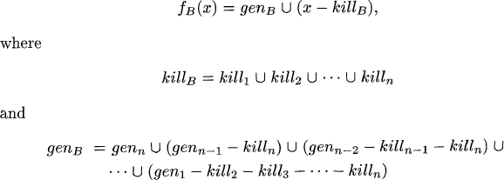
Transfer Equations for Reaching Definitions
Thus a block consisting of any number of statements. Suppose block B has n statement. The equation can be represented as below:

Slide 62
Transfer Equations for Reaching Definitions –
Basic Block
A basic block generates a set of definitions and kills a set of definitions.
The gen set contains all the definitions inside the block that are "visible" immediately after the block - we refer to them as downwards exposed.
A definition is downwards exposed in a basic block only if it is not "killed" by a subsequent definition to the same variable inside the same basic block.
A basic block's kill set is simply the union of all the definitions killed by the individual statements.
The notable fact is gen takes precedence, because in gen-kill form, the kill
set is applied before the gen set

Slide 63

Control-Flow Equations
Consider the set of constraints derived from the control flow between basic blocks.
since a definition cannot reach a point unless there is a path along which it reaches, IN[B] needs to be no larger than the union of the reaching definitions of all the predecessor blocks

Slide 64

Iterative Algorithm for Reaching Definitions
Let consider every control-flow graph has two empty basic blocks ENTRY and EXIT node
Initially consider
for all basic blocks B other than ENTRY,

Slide 65
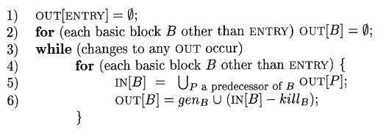
Iterative Algorithm for Reaching Definitions
INPUT: A flow graph for which kill_{B} and gen_{B} have been computed for each block B.
OUTPUT: IN[B] and OUT[B], the set of definitions reaching the entry and exit of each block B of the flow graph.

Slide 66
Example
d1 | d2 | d3 | d4 | d5 | d6 | d7
1 | 1 | 1 | 0 | 0 | 0 | 0
d1 | d2 | d3 | d4 | d5 | d6 | d7
0 | 0 | 1 | 1 | 1 | 0 | 0
Block B | OUT[B]0 | IN[B]1 | OUT[B]1
B1 | 000 0000 | 000 0000 | 111 0000
B2 | 000 0000 | 111 0000 | 001 1100
B3 | 000 0000 | 001 1100 | 000 1110
B4 | 000 0000 | 001 1110 | 001 0111
EXIT repared by R I Min | 000 0000 u | 001 0111 | 001 0111
P

Slide 67
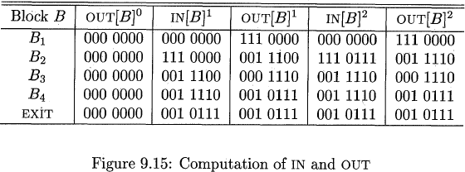
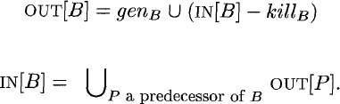
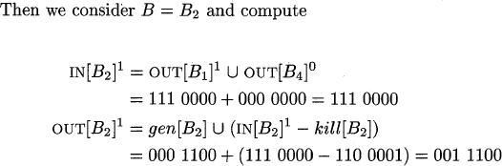
Example

Slide 68

Example
At the end of the first pass, 0UT[B2]1 = 001 1100, reflecting the fact that d4 and d5 are generated in B2, while d3 reaches the beginning of B2 and is not killed in B2.
Notice that after the second round, 0UT[B2] has changed to reflect the fact that d6 also reaches the beginning of B2 and is not killed by B2.
We did not learn that fact on the first pass, because the path from d6 to the end of B2, which is B3 → B4 → B2, is not traversed in that order by a single pass.
That is, by the time we learn that d6 reaches the end of B4, we have
already computed IN[B2] and OUT[B2] on the first pass.

Slide 69
Optimization of Basic Blocks

Slide 70
The DAG Representation of Basic Blocks - The need
One of the important techniques for local optimization begin by transforming a basic block into a DAG (directed acyclic graph).
The DAG creation for a basic block as follows:
Condition for Basic blocks | DAG Representation
For each of the initial values of the variables appearing in the basic block | Considered as Node
With each statement s within the block | Considered Node N is associated with s (statement)
Statements that are the last definitions, prior to s, and of the operands used by s | Considered Children's of N
Variables which are live on exit from the block | Considered as output nodes
Calculation of these "live variables" is a matter for global flow analysis

Slide 71
The DAG Representation of Basic Blocks
Using DAG following code improving transformations can be done
We can eliminate local common sub-expressions, that is, instructions that compute a value that has already been computed.
We can eliminate dead code, that is, instructions that compute a value that is never used.
We can reorder statements that do not depend on one another; such reordering may reduce the time a temporary value needs to be preserved in a register.
We can apply algebraic laws to reorder operands of three-address instructions, and sometimes hereby simplify the computation

Slide 72
Finding Local Common Sub expressions
Common sub-expressions can be detected by noticing, as a new node M is about to be added, whether there is an existing node N with the same children, in the same order, and with the same operator.
If so, N computes the same value as M and may be used in its place.
This technique was introduced as the "value-number" method of detecting common sub-expressions

Slide 73
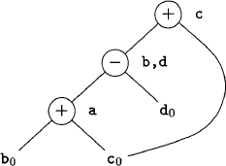

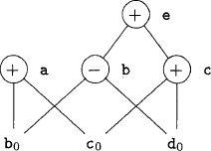

Example

Slide 74



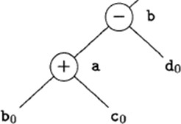
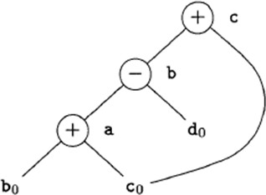




a = b + c
b = a - d
c = b + c
d = a - d
1. a = b + c
2. b = a - d
3. c = b + c
4. d = a - d
Here b is already used in statement (2) and labelled -
Also it is the most recent definition of b.
Thus, we do not confuse the values computed at statements one and three.
In this statement operator - and the nodes
with attached variables a and do as children.
Since the operator and the children are the same as those for the node corresponding to statement (2)
No need to create this node, but add d to the list of definitions for the node labeled -.

Slide 75


Finding Local Common Sub expressions
It might appear that, since there are only three nonleaf nodes in the DAG , the basic block can be replaced by a block with only three statements.
In fact, if b is not live on exit from the block, then we do not need to
compute that variable, and can use d to receive the value represented by the node labeled -.
The block then becomes
a = b + c
b = a - d
c = b + c
d = a - d
a = b + c
d = a - d
c = d + c

Slide 76
Dead Code Elimination
The operation on DAG's that corresponds to dead-code elimination can be implemented as follows.
We delete from a DAG any root (node with no ancestors) that has no live variables attached.
Repeated application of this transformation will remove all nodes from the DAG that correspond to dead code.

Slide 77

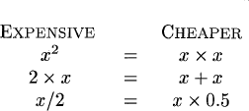
The Use of Algebraic Identities
1. Algebraic identities represent another important class of optimizations on basic blocks. For example, we may apply arithmetic identities, such as
2. Another class of algebraic optimizations includes local reduction in strength, that is, replacing a more expensive operator by a cheaper one as in:

Slide 78
The Use of Algebraic Identities
3. A third class of related optimizations is constant folding. Here we evaluate constant expressions at compile time and replace the constant expressions by their value
Thus the expression 2 * 3.14 would be replaced by 6.28.
Many constant expressions arise in practice because of the frequent use of symbolic constants in programs.

Slide 79

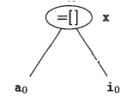
Representation of Array References
The proper way to represent array accesses in a DAG is as follows.
Now consider a block of code given below:
1. x = a[i]
x = a[i]
a[j] = y
z= a[i]
An assignment from an array, like x = a[i] , is represented by creating a node with operator =[] and two children representing the initial value of the array, a0 in this case, and the index i. Variable x becomes a label of this new node.

Slide 80
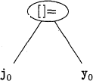

Representation of Array References
An assignment to an array, like a[j] = y, is represented by a new node with operator []= and three children representing a0, j and y. There is no variable labelling this node.
2. a[j] = y

Slide 81
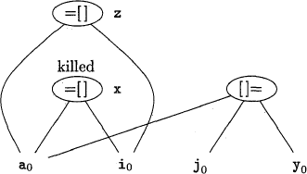

Representation of Array References
The creation of node according to line 3. will kills all currently constructed
nodes whose value depends on ao
A node that has been killed cannot receive any more labels; that is, it cannot become a common subexpression.
So the final DAG looks as shown below:
x = a[i]
a[j] = y
z= a[i]

Slide 82

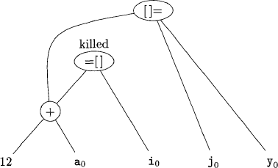

Representation of Array References - Examples
x
b

Slide 83


Pointer Assignments
Consider an example:
x = *p
*q = y
The operator =* will take all nodes that are currently associated with identifiers as arguments, which is relevant for dead-code elimination.
The *= operator kills all other nodes so far constructed in the DAG.
So, There are global pointer analyses one could perform that might limit the set of variables a pointer could reference at a given place in the code.
Even local analysis could restrict the scope of a pointer
Procedure calls behave much like assignments through pointers

Slide 84
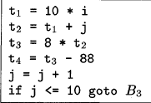

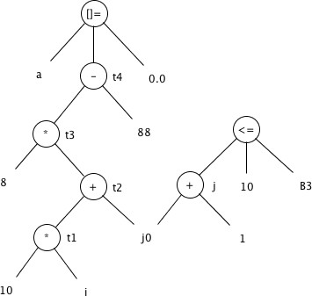
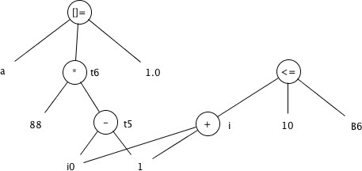
Examples

Slide 85
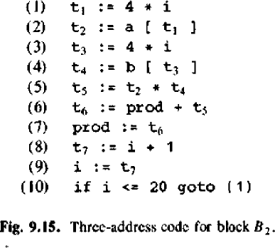
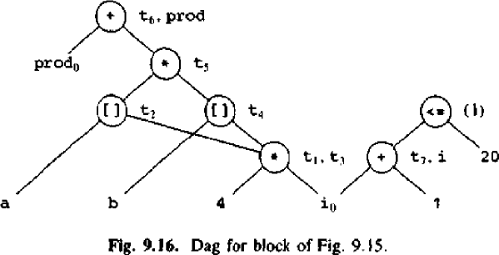
Examples

Slide 86
Reassembling Basic Blocks From DAG's
After performing whatever optimizations are possible while constructing the DAG or by manipulating the DAG once constructed, we may reconstitute the three- address code.
For each node that has one or more attached variables, we construct a three- address statement that computes the value of one of those variables.
We prefer to compute the result into a variable that is live on exit from the block.
However, if we do not have global live-variable information to work from, we need to assume that every variable of the program is live on exit from the block.
If the node has more than one live variable attached, then we have to introduce copy statements to give the correct value to each of those variables.
Sometimes, global optimization can eliminate those copies, if we can arrange to use one of two variables in place of the other.

Slide 87





Reassembling Basic Blocks From DA
a = b + c
b = a - d
c = b + c
d = a - d
Copy statement
a = b + c
d = a - d
c = d + c
a = b + c
d = a – d
b=d
c = d + c
or

Slide 88
Run time Environment Source Language Issues

Slide 89
Run-Time Environments
A compiler must accurately implement the abstractions embodied in the source language definition.
These abstractions typically include names, scopes, bindings, data types, operators, procedures, parameters, and flow-of-control constructs.
The compiler must cooperate with the operating system and other systems software to support these abstractions on the target machine.
To do so, the compiler creates and manages a run-time environment in which it assumes its target programs are being executed.

Slide 90
Run-Time Environments - Issues
This environment deals with a variety of issues such as
The layout and allocation of storage locations for the objects named in the source program
The mechanisms used by the target program to access variables
The linkages between procedures
The mechanisms for passing parameters
The interfaces to the operating system, input/output devices, and other programs.

Slide 91
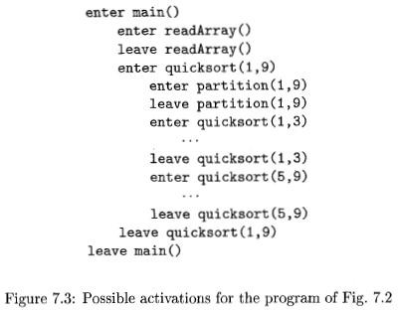
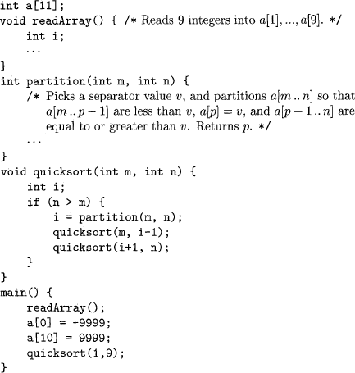

Example-Explanation
The main function has three tasks.
It calls readArray, sets the sentinels, and
Then calls quicksort on the entire data array.
The possible sequence of call is shown
In this execution, the call to partition(1,9) returns 4,
so a[1] through a[3] hold elements less than its chosen separator
value v,
while the larger elements are in a[5] through a[9].

Slide 92
Procedure activations
p procedure
q procedure
Procedure activations are nested in time.
If an activation of procedure p calls procedure q, then that activation of q must end before the activation of p can end.
There are three common cases:
The activation of q terminates normally | Then in essentially any language, control resumes just after the point of p at which the call to q was made
The activation of q, or some procedure q called, either directly or indirectly, aborts | p ends simultaneously with q.
The activation of q terminates because of an exception that q cannot handle | Procedure p may handle the exception, in which case the activation of q has terminated while the activation of p continues

Slide 93

Activation Trees
The activations of procedures during the running of an entire program can be represented as tree structure called as activation tree.
In the tree each node corresponds to one activation
The root is the activation of the "main" procedure that initiates execution of the program.
At a node for an activation of procedure p, the children correspond to activations of the procedures called by this activation of p.
We show these activations in the order that they are called, from left to right.
Notice that one child must finish before the activation to its right can begin.

Slide 94
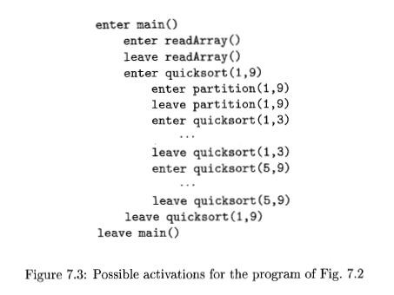
Activation Tree
Sort
r q(1,9)
p(1,9)
q(1,3)
q(5,9)
returns 4
p(1,3)
q(1,0)
q(2,3)
p(5,9)
returns 6
q(5,5)
q(7,9)
returns 1
p(2,3)
q(2,1)
q(3,3)
p(7,9)
returns 8
q(7,7)
q(9,9)
returns 2

Slide 95
Control stack
Flow of control in program corresponds to depth first traversal of activation tree
Use a stack called control stack to keep track of live procedure activations
Push the node when activation begins and pop the node when activation ends
When the node n is at the top of the stack the stack contains the nodes along the path from n to the root

Slide 96
Run time Environment- Storage Organization

Slide 97




Storage Organization
From the perspective of the compiler writer:
The executing target program runs in its own logical address space in which each program value has a location.
The management and organization of this logical address space is shared between the compiler, operating system, and target machine.
The operating system maps the logical addresses into physical addresses, which are usually spread throughout memory.

Slide 98
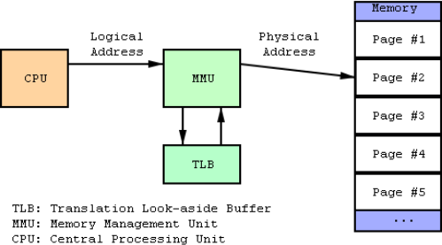
Logical vs Physical address
BASIS FOR COMPARISON | LOGICAL ADDRESS | PHYSICAL ADDRESS
Basic | It is the virtual address generated by CPU | The physical address is a location in a memory unit.
Address Space | Set of all logical addresses generated by CPU in reference to a program is referred as Logical Address Space. | Set of all physical addresses mapped to the corresponding logical addresses is referred as Physical Address.
Visibility | The user can view the logical address of a program. | The user can never view physical address of program
Access | The user uses the logical address to access the physical address. | The user can not directly access physical address.

Slide 99
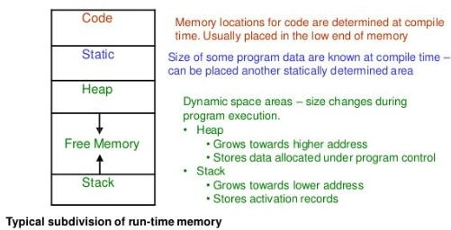
Storage Organization
The run-time representation of an object program in the logical address space
consists of data and program areas
The stack is used to store data structures called activation records that get generated during procedure calls

Slide 100
Runtime Storage management
The executing program runs in its own logical address space that was partitioned into four code and data areas:
A statically determined area Code that holds the executable target code. The size of the target code can be determined at compile time.
A statically determined data area Static for holding global constants and other data generated by the compiler. The size of the global constants and compiler data can also be determined at compile time.
A dynamically managed area Heap for holding data objects that are allocated and freed during program execution. The size of the Heap cannot be determined at compile time.
A dynamically managed area Stack for holding activation records as they are created and destroyed during procedure calls and returns. Like the Heap, the size of the Stack cannot be determined at compile time.

Slide 101
Activation Records
Procedure calls and returns are usually managed by a run-time stack called the control stack. Each live activation has an activation record
The root of the activation tree will be at the bottom of the stack
The entire sequence of activation records on the stack corresponding to the path in the activation tree to the activation where control currently resides.
The latter activation has its record at the top of the stack

Slide 102

A general activation record

Slide 103
Run time Environment- Storage Allocation Strategies

Slide 104
Storage Allocation Strategies
The following three different storage allocation strategy were used
Static allocation lays out storage for all data objects at compile time
Stack allocation manages the run time storage as a stack
Heap allocation allocated and deallocates storages as needed at run time from a data area known as a heap

Slide 105

Stack Allocation of Space
Almost all compilers for languages that use procedures, functions, or methods as units of user-
defined actions manage at least part of their run-time memory as a stack.
Each time a procedure is called, space for its local variables is pushed onto a
stack, and when the procedure terminates, that space is popped off the stack.
This arrangement not only allows space to be shared by procedure calls whose durations do not overlap in time, but it allows us to compile code for a procedure in such a way that the relative addresses of its nonlocal variables are always the same, regardless of the sequence of procedure calls
93

Slide 106

A general activation record
Prepared by R I Minu
94

Slide 107





Procedure r is activated When control reaches the first call in the body of main and its activation record is pushed onto the stack.
The activation record for r contains space for local variable i.
When control returns from this activation, its record is popped, leaving just the record for main on the stack.
Control then reaches the call to q (quicksort) with actual parameters 1 and 9, and an activation record for this call
is placed on the top of the stack.
Prepared by R I Minu
95

Slide 108


The activation record for q contains space for the parameters m and n and the local variable i.
Notice that space once used by the call of r is reused on the stack.
No trace of data local to r will be available to q(1,9).
When q(1,9) returns, the stack again has only the activation record for main.
A recursive call to q(1,3) was made.
Activations p(1,3) and q(1,0) have begun and ended during the lifetime of q(l,3), leaving the activation record for q(l,3) on
top
Prepared by R I Minu 96

Slide 109
Calling Sequences
Procedure calls are implemented by calling sequences
It consists of code that allocates an activation record on the stack and enters information into its fields
The code in a calling sequence is often divided between
The calling procedure (the "caller")
The procedure it calls (the "callee")

Slide 110
Principles behind Calling Sequences
Values communicated between caller and callee are generally placed at the beginning of the callee’s activation record, so they are as close as possible to the caller's activation record
Fixed-length items are generally placed in the middle. such items typically include the control link, the access link, and the machine status fields (refer the activation record)
Items whose size may not be known early enough are placed at the end of the activation record.
We must locate the top-of-stack pointer judiciously. A common approach is to have it point to the end of the fixed-length fields in the activation record

Slide 111


Slide 112


Slide 113
Variable-Length Data on the Stack
The run-time memory-management system must deal frequently with the allocation of space for objects the sizes of which are not known at compile time
But which are local to a procedure and thus may be allocated on the stack.
In modern languages, objects whose size cannot be determined at compile time are allocated space in the heap
‹#›

Slide 114



Let consider procedure p has three local arrays, whose sizes be determined at compile time.
The storage for these arrays is not part of the activation record for p.
Only a pointer to the beginning of each array appears in the activation record itself.
Thus, when p is executing, these pointers are at known offsets from the top-of-stack pointer, so the target code can
access array elements through these pointers.
The activation record for a procedure q, called by p.
The activation record for q begins after the arrays of p, and any variable-length arrays of q are located beyond that.
Access to the data on the stack is through two pointers, top and top-
sp.
Here, top marks the actual top of stack; it points to the position at which the next activation record will begin.
The second, top-sp is used to find local, fixed-length fields of the top
activation record.
The code to reposition top and top-sp can be generated at compile time in terms of sizes that will become known at run time.
When q returns, top-sp can be restored from the saved control link in
the activation record for q.
The new value of top is top-sp minus the length of the machine- status, control and access link, return-value, and parameter fields in q's activation record.
This length is known at compile time
‹#›

Slide 115

Heap Allocation
The heap is the portion of the store that is used for data that lives indefinitely, or until the program explicitly deletes
Memory Manager: The memory manager keeps track of all the free space in heap storage at all times. It performs two basic functions
Allocation. When a program requests memory for a variable or object, the memory manager produces a chunk of contiguous heap memory of the requested size. If space is exhausted, the memory manager passes that information back to the application program
Deallocation. The memory manager returns deallocated space to the pool of free space, so it can reuse the space to satisfy other allocation requests.
‹#›

Slide 116
Required properties of memory management
Space Efficiency. A memory manager should minimize the total heap space needed by a program
Program Efficiency. A memory manager should make good use of the memory subsystem to allow programs to run faster. By attention to the placement of objects in memory, the memory manager can make better use of space and, hopefully, make the program run faster
Low Overhead. Because memory allocations and deallocations are frequent operations in many programs, it is important that these operations be as efficient as possible
‹#›

Slide 117
Access to Nonlocal Data on the Stack
‹#›

Slide 118
Access to Nonlocal Data on the Stack
Now let us see how a procedure access their data that not belong to its own
That is the mechanism for finding data used within a procedure p but that does not belong to p.
Access becomes more complicated in languages where procedures can be declared inside other procedures.
‹#›

Slide 119
Data Access Without Nested Procedures
The global variable v has a scope consisting of all the functions that follow the declaration of v, except where there is a local definition of the identifier v
For languages that do not allow nested procedure declarations, allocation of storage for variables and access to those variables is simple
Global variables are allocated static storage.
The locations of these variables remain fixed and are known at compile time.
So to access any variable that is not local to the currently executing procedure, we simply use the statically determined address.
Any other name must be local to the activation at the top of the stack.
We may access these variables through the top-sp pointer of the stack.
‹#›

Slide 120
Data Access With Nested Procedures
Access becomes far more complicated when a language allows procedure declarations to be nested and also uses the normal static scoping rule;
Let us give nesting depth 1 to procedures that are not nested within any other procedure
‹#›

Slide 121
Access Links
A direct implementation of the normal static scope rule for nested functions is obtained by adding a pointer called the access link to each activation record.
If procedure p is nested immediately within procedure q in the source code, then the access link in any activation of p points to the most recent activation of q.
Note that the nesting depth of q must be exactly one less than the nesting depth of p.
‹#›

Slide 122
Access Links
Suppose that the procedure p at the top of the stack is at nesting depth 𝑛_{𝑝} and p needs to access x, which is an element defined within some procedure q that surrounds p and has nesting depth 𝑛_{𝑞}.
Then 𝑛_{𝑝}≥ 𝑛_{𝑞} only if p and q are the same procedure.
To find x, we start at the activation record for p at the top of the stack and follow the access link 𝑛_{𝑝}- 𝑛_{𝑞}times, from activation record to activation record.
‹#›

Slide 123


After sort has called readArray to load input into the array a and then called quicksort(1,9) to sort the array.
The access link from quicksort(1,9) points to the activation record for sort, not because sort called quicksort but
because sort is the most closely nested function surrounding quicksort in the program
In successive steps of recursive call to quicksort(1,3), followed by a call to partition, which calls exchange.
The quicksort(1,3)'s access link points to sort, for the same reason that quicksort(1,9)'s does.
The access link for exchange bypasses the activation records for quicksort and partition, since exchange is nested
immediately within sort.
That arrangement is fine, since exchange needs to access only the array a, and the two elements it must swap are
indicated by its own parameters i and j.
Prepared by R I Minu 111

Slide 124
Parameter Passing
Call by value
actual parameters are evaluated and their r-values are passed to the called procedure
caller evaluates the actual parameters and places r value in the storage for
formals
call has no effect on the activation record of caller
Call by reference (call by address)
the caller passes a pointer to each location of actual parameters
if actual parameter is a name then l-value is passed
if actual parameter is an expression then it is evaluated in a new location and the address of that location is passed
‹#›

Slide 125
Parameter Passing
Copy Restore
A hybrid between call by value and call by reference
Also called as copy-in copy-out/ call by value result
actual parameters are evaluated, rvalues are passed by call by value, lvalues are determined before the call
when control returns, the current rvalues of the formals are copied into lvalues of
the locals
Call by name
The procedure is treated as if it were a macro, its body is substituted for the call in
the caller with the actual parameters
The local names of the called procedure are kept distinct from the names of the calling procedure
The actual parametes are surrounded by parentheses if necessary to preserve their
integrity
‹#›

Slide 126

End of unit 5
‹#›

